Slide 1

S1:
KONGU ENGINEERING COLLEGE ,PERUNDURAI
(Autonomous)
22CST42-WEB TECHNOLOGY
MINI PROJECT
Presented By ,
23CSR141 - NANDHINI A
23CSL260-PRAVIN KUMAR G

Slide 2
S2:
RANDOM MEAL GENERATOR
PROBLEM STATEMENT
People struggle to find new and exciting meal ideas based on the ingredients, resulting in repetitive cooking.

Slide 3
S3:
*.Our solution is a user-friendly random meal generator that helps
people to discover fresh recipes based on their available ingredients.
*.It provides step-by-step instructions and video tutorials to reduce repetitive cooking, saving time and
Promoting new recipes.......
SOLUTION

Slide 4
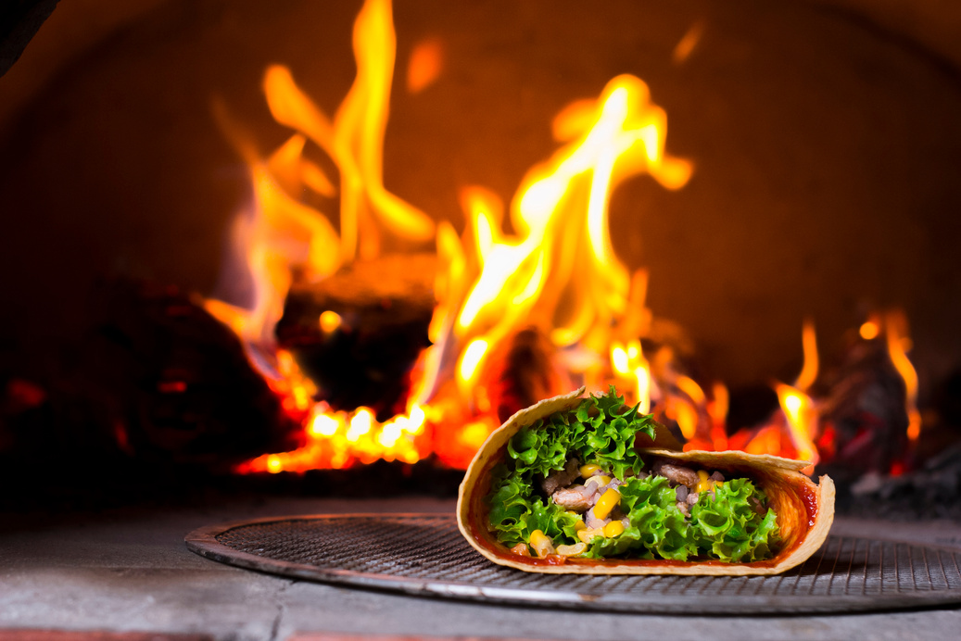
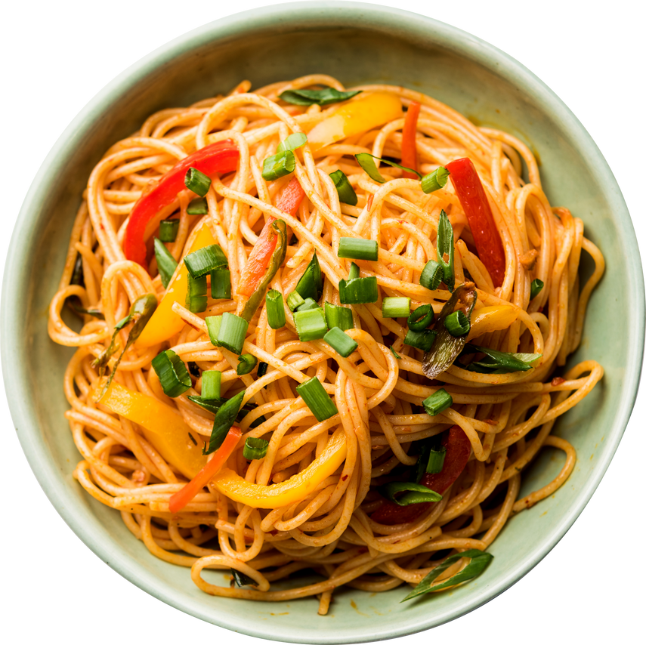
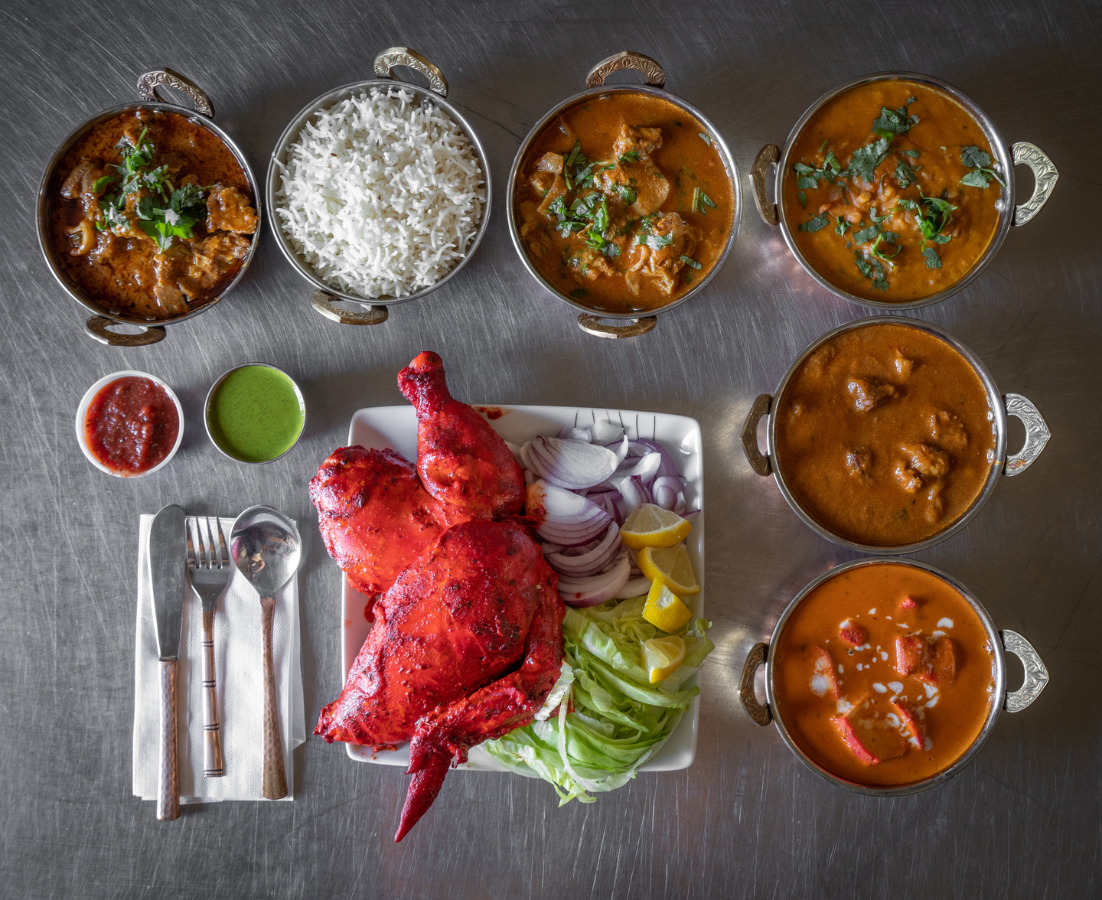
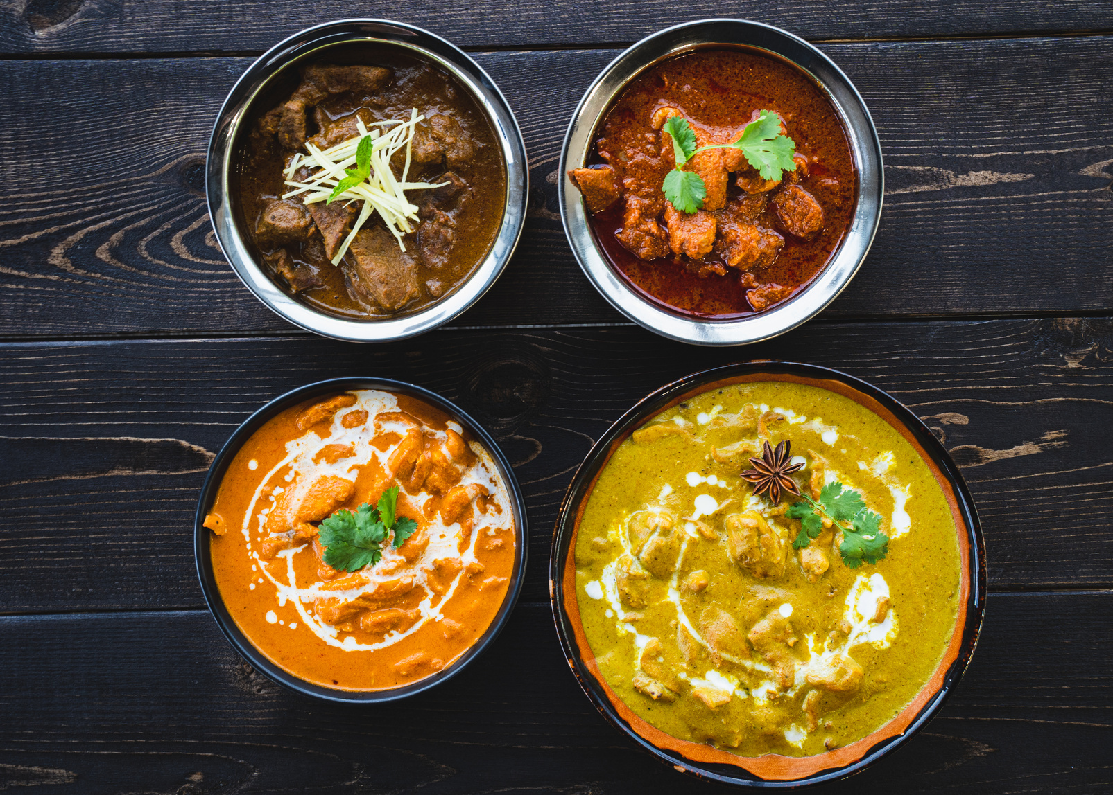
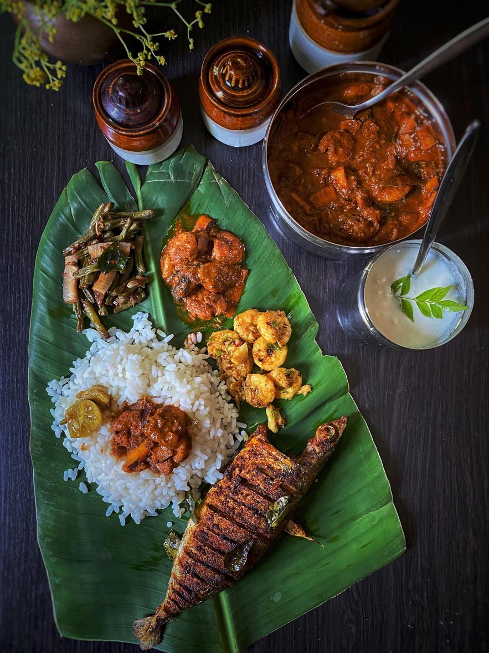
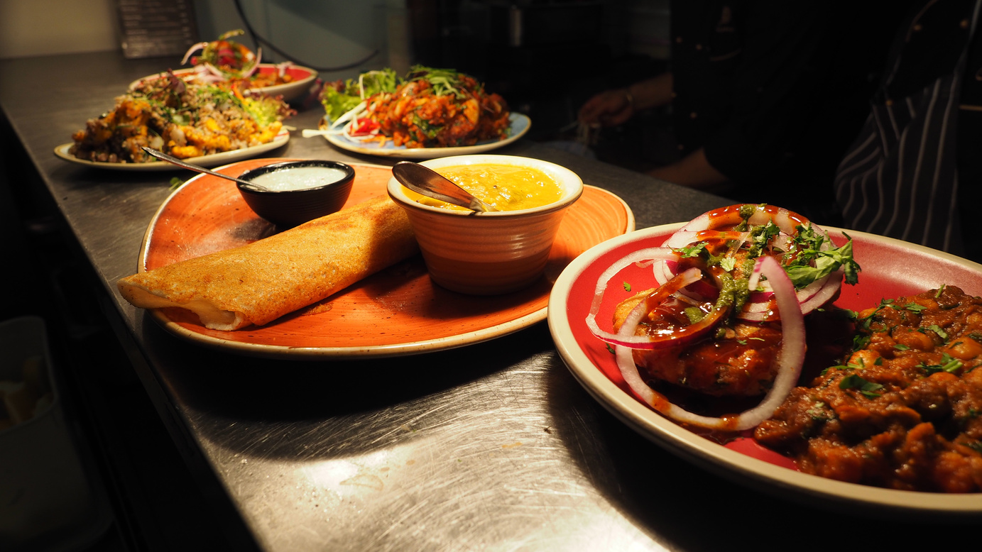
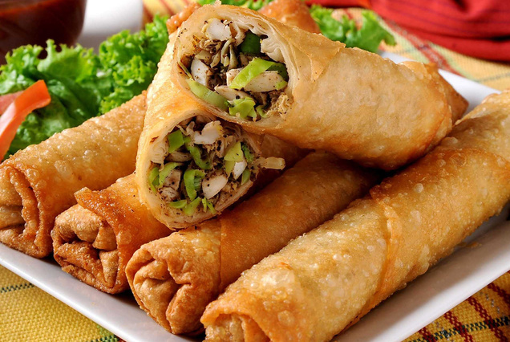
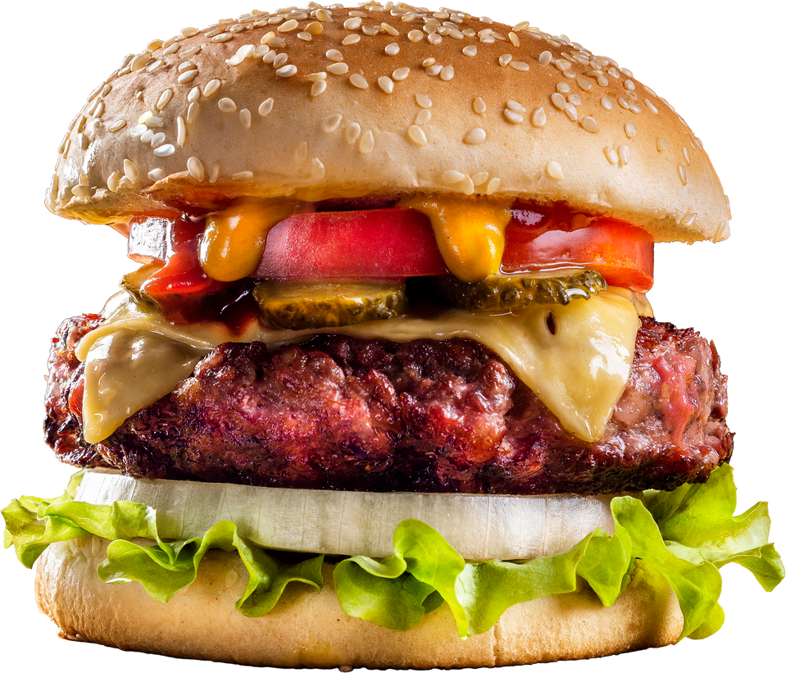
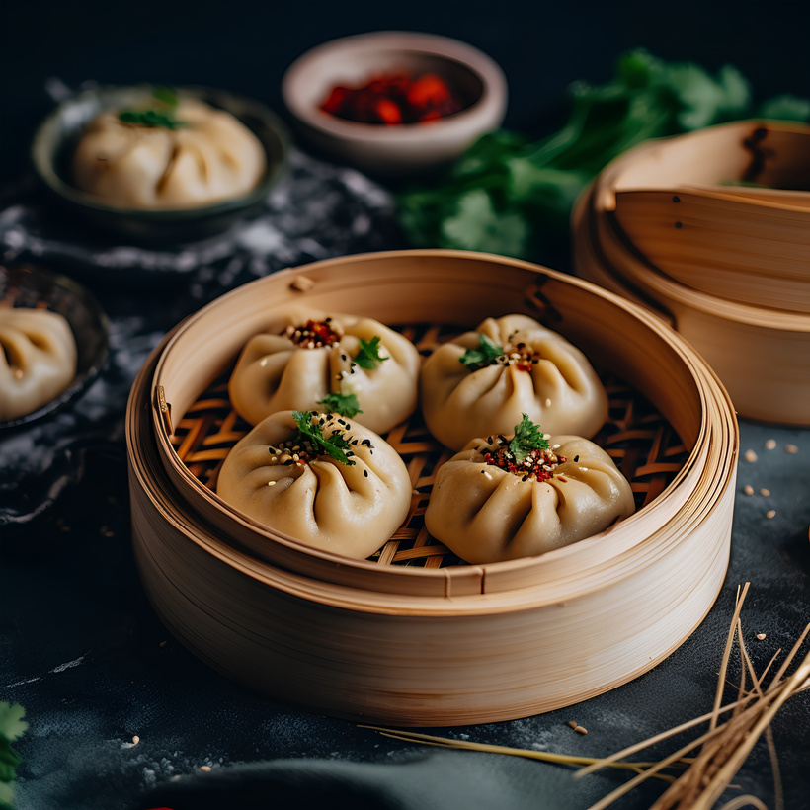
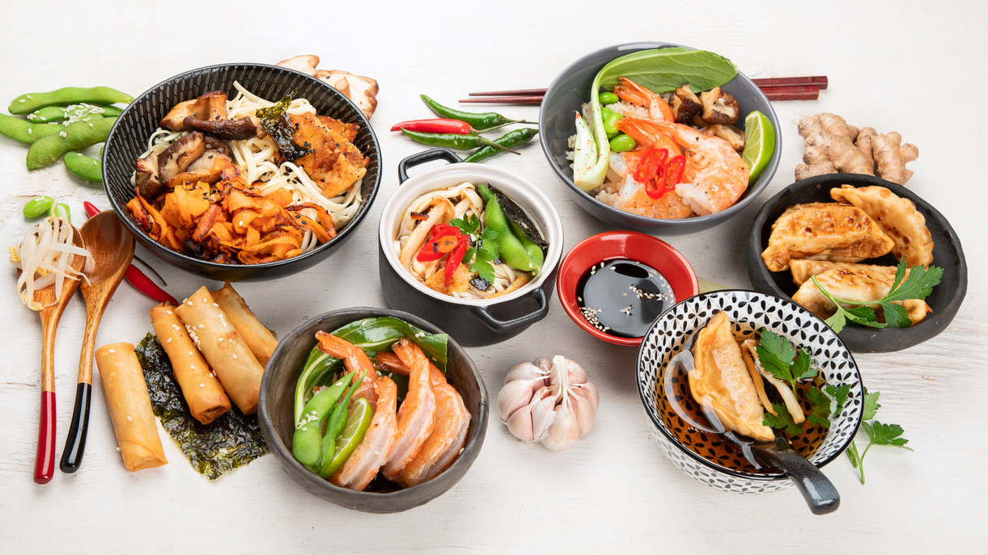
S4:
LANGUAGES
The Languages used here is:
HTML
CSS
JAVA SCRIPT

Slide 5
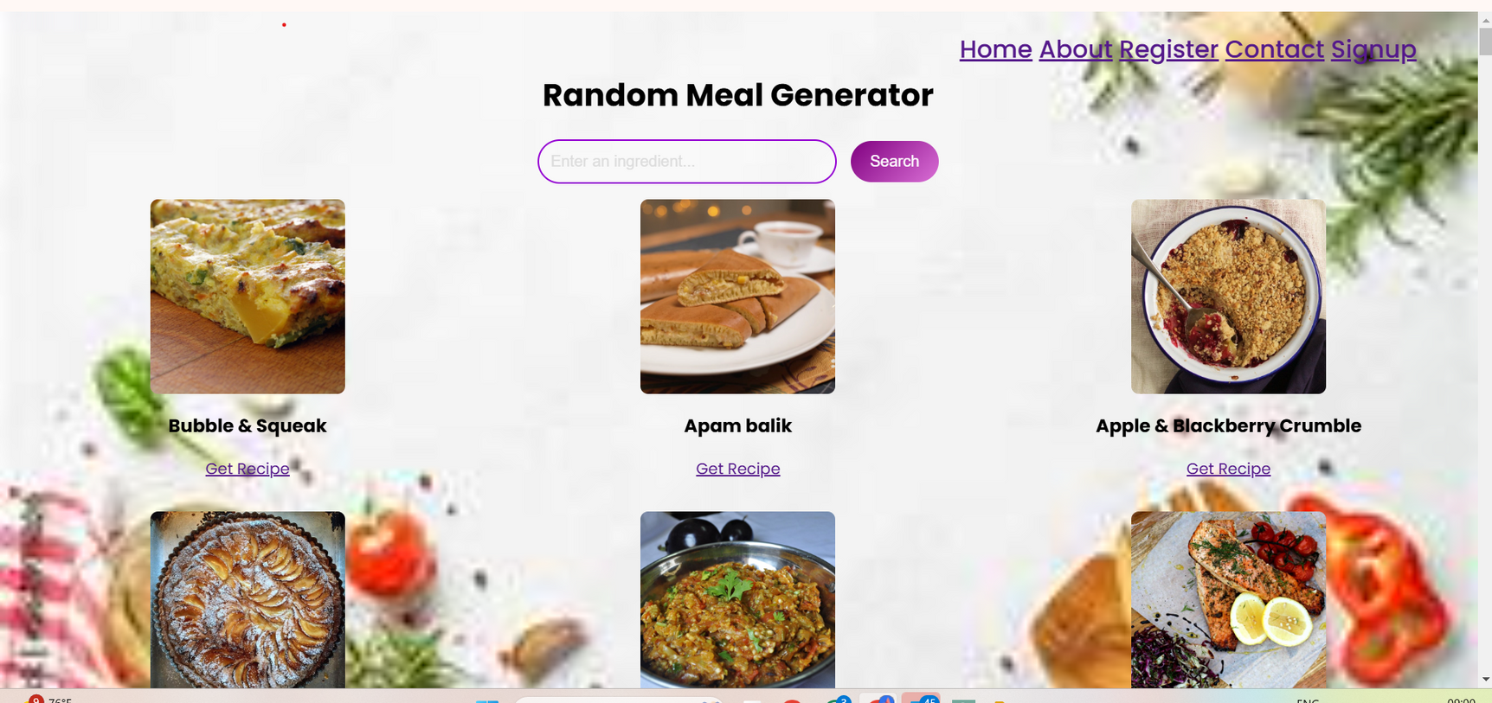
S5:
OUTPUT:
HOME PAGE

Slide 6
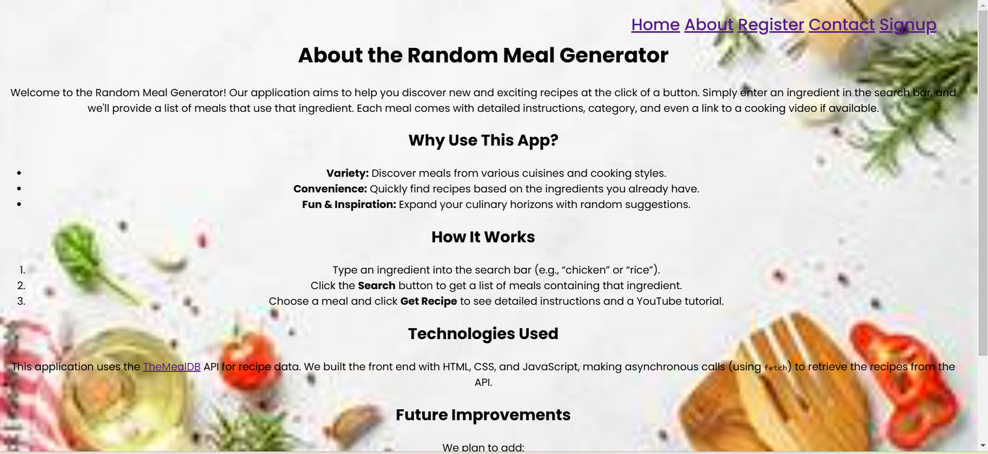
S6:
OUTPUT: ABOUT

Slide 7
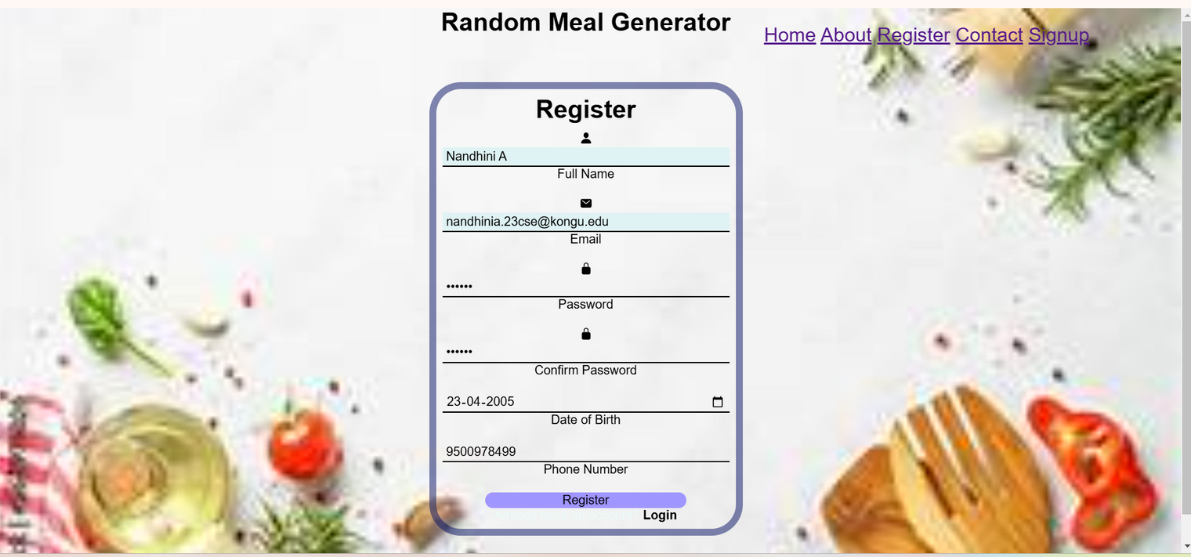
S6:
OUTPUT: REGISTER

Slide 8
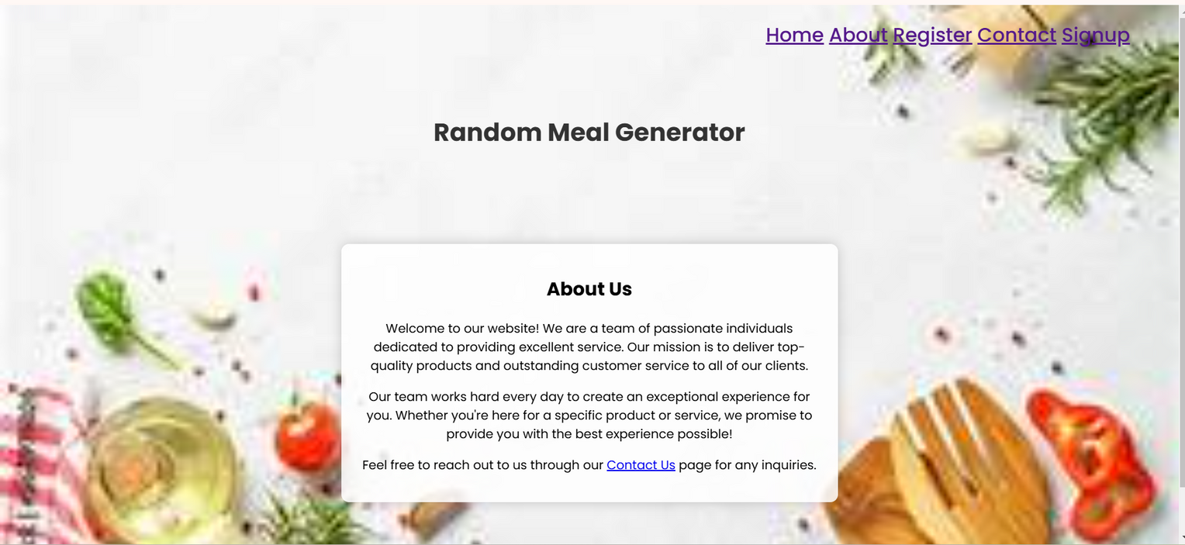
S7:
OUTPUT: CONTACT PAGE

Slide 9
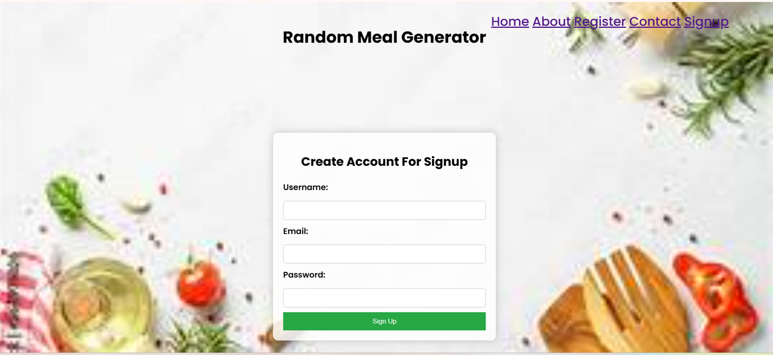
S8:
OUTPUT: SIGNUP PAGE

Slide 10
THANK YOU!!!!!!!!!!!!!!

